Slide 1
Linear Regression (선형회귀)
Sang Yup Lee

Slide 2
Machine learning
지도학습 알고리즘이 적용될 수 있는 문제 유형 (종속변수의 유형에 따라 결정)
회귀문제 (Regression problem)
When the DV is a continuous variable
분류문제 (Classification problem)
When the DV is a categorical (or nominal) variable
어떠한 모형 (혹은 알고리즘)을 선택의 중요 기준
문제의 유형
회귀문제에 적용되는 대표적 모형 => 선형회귀모형

Slide 3
Linear Regression
A type of supervised learning
It uses training data that have information both IVs and DV.
That is, it learns the relationship between IVs and DV in the training data.
It finds the optimal values of the parameters of the selected model
The model is “linear regression model.”
Using the parameters, it predicts DV values of new data that only have info about IVs

Slide 4
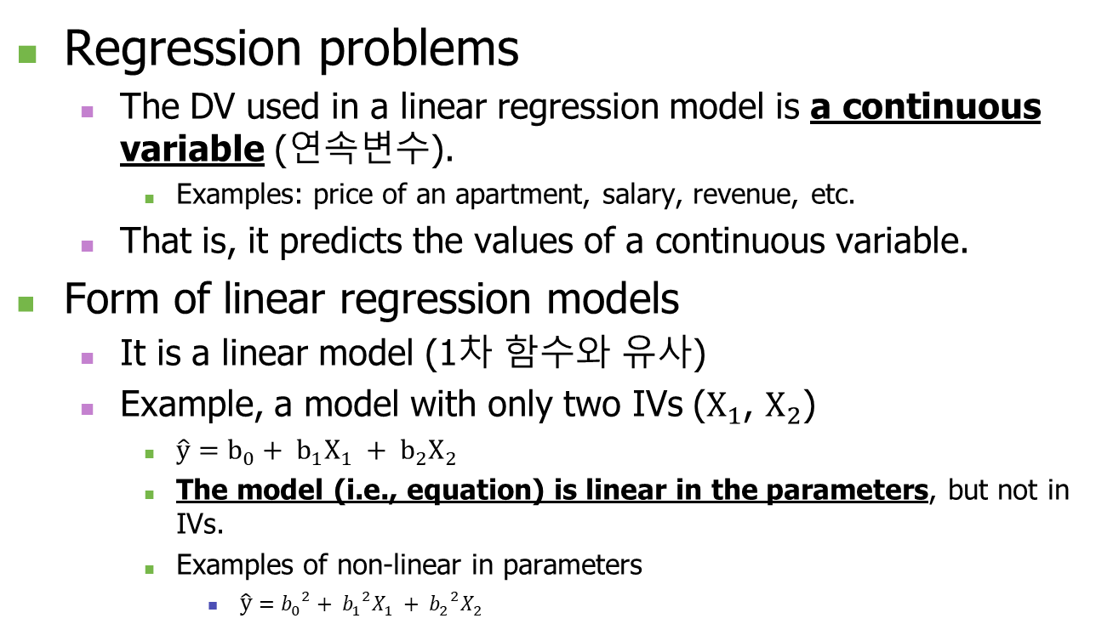
Linear Regression
Regression problems
The DV used in a linear regression model is a continuous variable (연속변수).
Examples: price of an apartment, salary, revenue, etc.
That is, it predicts the values of a continuous variable.
Form of linear regression models
It is a linear model (1차 함수와 유사)
Example, a model with only two IVs ($X_{1}$, $X_{2}$)
$\hat{y}=b_{0}+ b_{1}X_{1} + b_{2}X_{2}$
The model (i.e., equation) is linear in the parameters, but not in IVs.
Examples of non-linear in parameters
$\hat{y}={b_{0}}^{2}+ {b_{1}}^{2}X_{1} + {b_{2}}^{2}X_{2}$

Slide 5
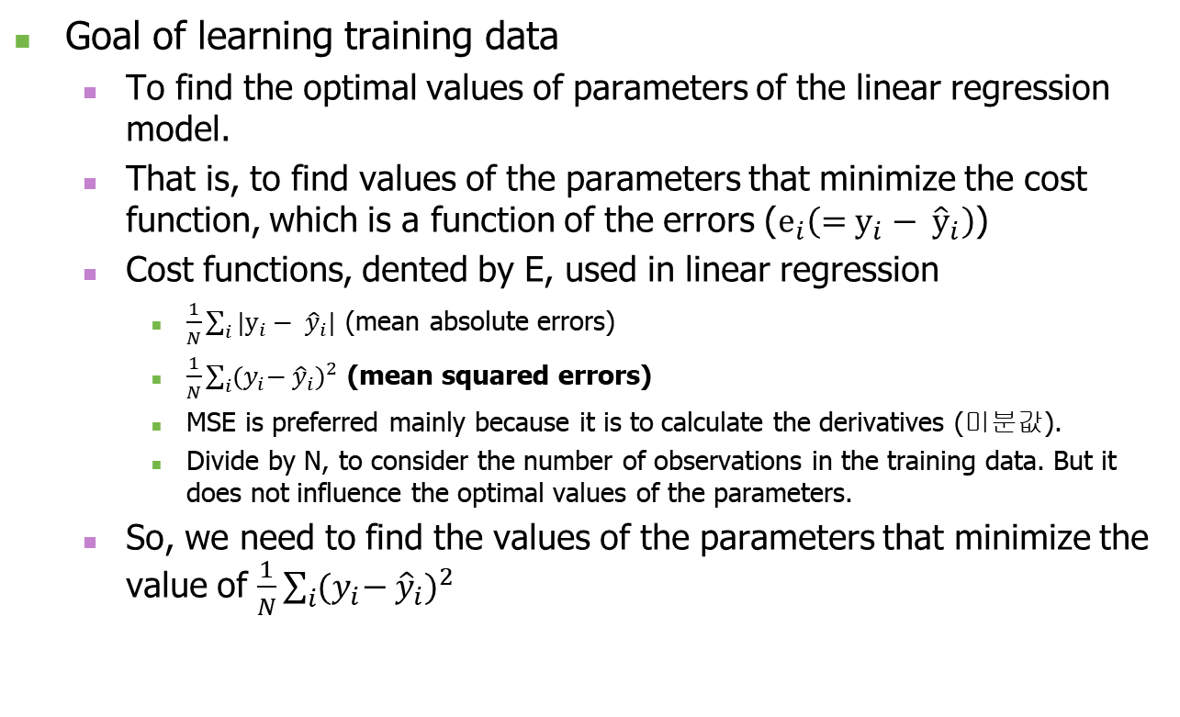
Linear Regression
Goal of learning training data
To find the optimal values of parameters of the linear regression model.
That is, to find values of the parameters that minimize the cost function, which is a function of the errors ($e_{i}\left(=y_{i}− {\hat{y}}_{i}\right)$)
Cost functions, dented by E, used in linear regression
$\frac{1}{N}\sum_{i}{{|y}_{i}− {\hat{y}}_{i}|}$ (mean absolute errors)
$\frac{1}{N}\sum_{i}{{{(y}_{i}− {\hat{y}}_{i})}^{2}}$ (mean squared errors)
MSE is preferred mainly because it is to calculate the derivatives (미분값).
Divide by N, to consider the number of observations in the training data. But it does not influence the optimal values of the parameters.
So, we need to find the values of the parameters that minimize the value of $\frac{1}{N}\sum_{i}{{{(y}_{i}− {\hat{y}}_{i})}^{2}}$

Slide 6
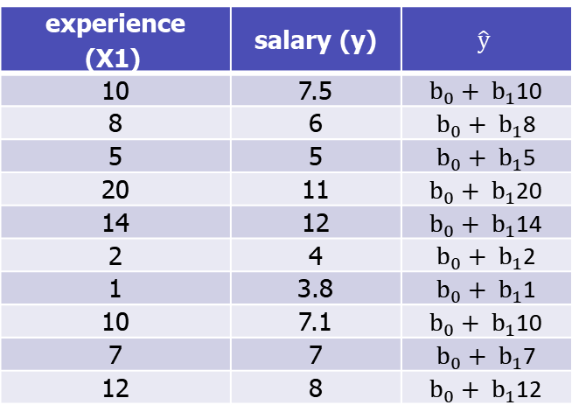

Linear Regression
Example: salary data
Chosen model: $\hat{y}=b_{0}+ b_{1}X_{1}$, where $X_{1}$ is the experience in years (경력), y is the salary (연봉)
Training data
experience (X1) | salary (y)
10 | 7.5
8 | 6
5 | 5
20 | 11
14 | 12
2 | 4
1 | 3.8
10 | 7.1
7 | 7
12 | 8
experience (X1) | salary (y) | $$\hat{y}$$
10 | 7.5 | $b_{0}+ b_{1}$10
8 | 6 | $b_{0}+ b_{1}$8
5 | 5 | $b_{0}+ b_{1}$5
20 | 11 | $b_{0}+ b_{1}$20
14 | 12 | $b_{0}+ b_{1}$14
2 | 4 | $b_{0}+ b_{1}$2
1 | 3.8 | $b_{0}+ b_{1}$1
10 | 7.1 | $b_{0}+ b_{1}$10
7 | 7 | $b_{0}+ b_{1}$7
12 | 8 | $b_{0}+ b_{1}$12

Slide 7
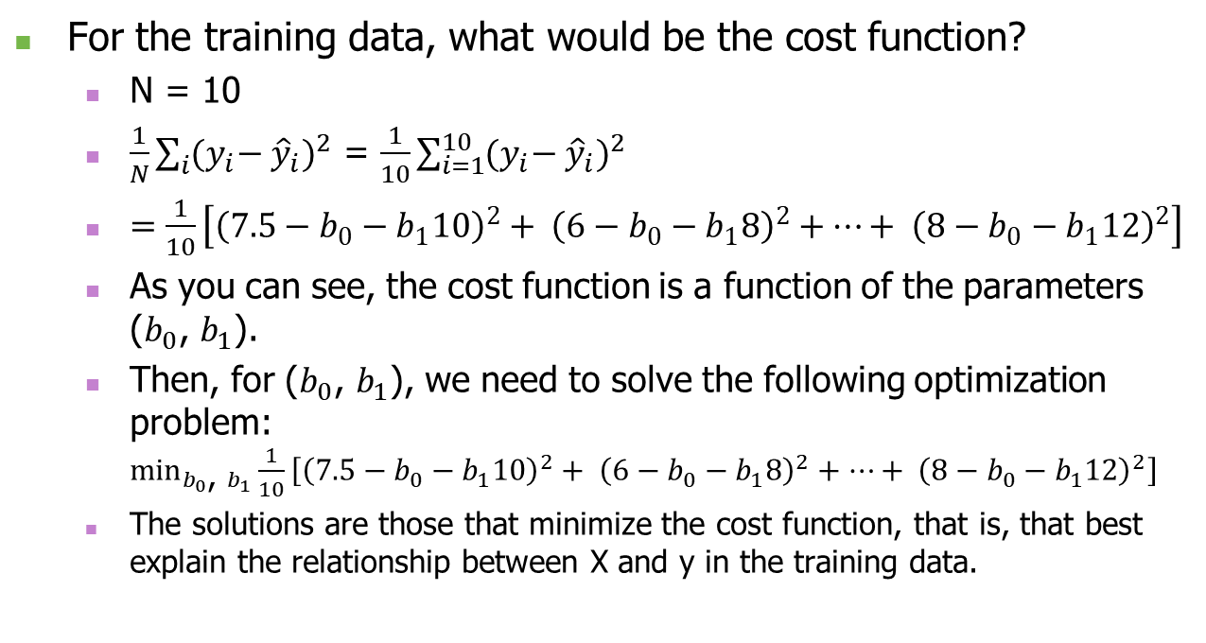
Linear Regression
For the training data, what would be the cost function?
N = 10
$\frac{1}{N}\sum_{i}{{{(y}_{i}− {\hat{y}}_{i})}^{2}}$ = $\frac{1}{10}\sum_{i=1}^{10}{{{(y}_{i}− {\hat{y}}_{i})}^{2}}$
$=\frac{1}{10}\left[{\left(7.5−b_{0}−b_{1}10\right)}^{2}+ {\left(6−b_{0}−b_{1}8\right)}^{2}+…+ {\left(8−b_{0}−b_{1}12\right)}^{2}\right]$
As you can see, the cost function is a function of the parameters ($b_{0}$, $b_{1}$).
Then, for ($b_{0}$, $b_{1}$), we need to solve the following optimization problem: $\min_{b_{0}\text{, }b_{1}}{\frac{1}{10}\left[{\left(7.5−b_{0}−b_{1}10\right)}^{2}+ {\left(6−b_{0}−b_{1}8\right)}^{2}+…+ {\left(8−b_{0}−b_{1}12\right)}^{2}\right]}$
The solutions are those that minimize the cost function, that is, that best explain the relationship between X and y in the training data.

Slide 8
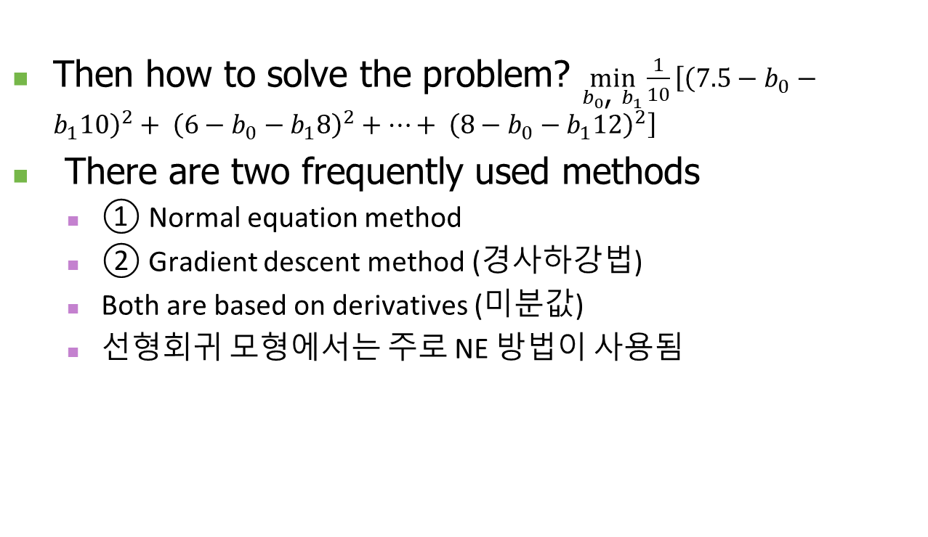
Linear Regression
Then how to solve the problem? $\min_{b_{0}\text{, }b_{1}}{\frac{1}{10}\left[{\left(7.5−b_{0}−b_{1}10\right)}^{2}+ {\left(6−b_{0}−b_{1}8\right)}^{2}+…+ {\left(8−b_{0}−b_{1}12\right)}^{2}\right]}$
There are two frequently used methods
① Normal equation method
② Gradient descent method (경사하강법)
Both are based on derivatives (미분값)
선형회귀 모형에서는 주로 NE 방법이 사용됨

Slide 9
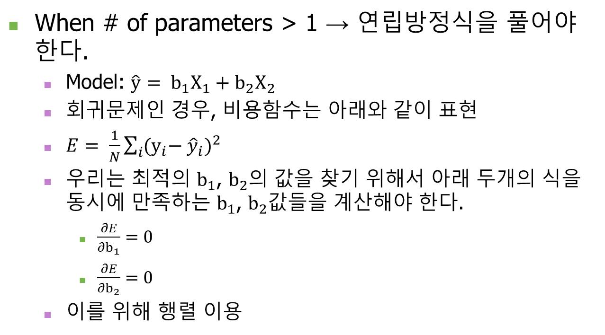
Minimization of cost function
When # of parameters > 1 → 연립방정식을 풀어야 한다.
Model: $\hat{y}= b_{1}X_{1}+b_{2}X_{2}$
회귀문제인 경우, 비용함수는 아래와 같이 표현
$E= \frac{1}{N}\sum_{i}{{{(y}_{i}− {\hat{y}}_{i})}^{2}}$
우리는 최적의 $b_{1}$, $b_{2}$의 값을 찾기 위해서 아래 두개의 식을 동시에 만족하는 $b_{1}$, $b_{2}$값들을 계산해야 한다.
$\frac{∂E}{∂b_{1}}=0$
$\frac{∂E}{∂b_{2}}=0$
이를 위해 행렬 이용

Slide 10
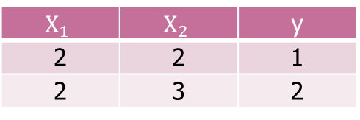
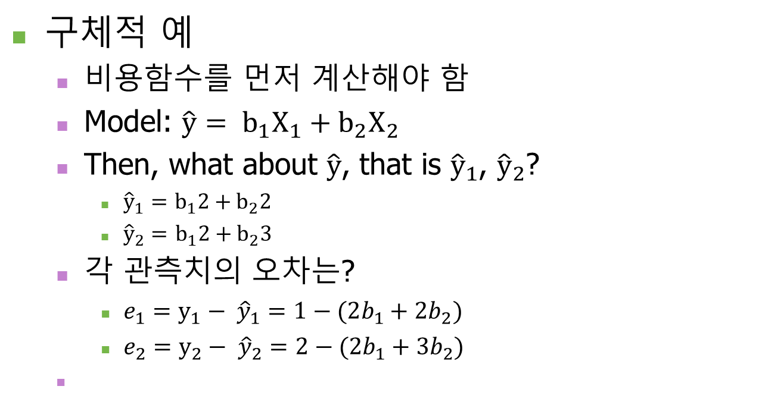
Minimization of cost function
구체적 예
비용함수를 먼저 계산해야 함
Model: $\hat{y}= b_{1}X_{1}+b_{2}X_{2}$
Then, what about $\hat{y}$, that is ${\hat{y}}_{1}$, ${\hat{y}}_{2}$?
${\hat{y}}_{1}=$ $b_{1}2+b_{2}2$
${\hat{y}}_{2}=$ $b_{1}2+b_{2}3$
각 관측치의 오차는?
$e_{1}=y_{1}− {\hat{y}}_{1}=1−(2b_{1}+2b_{2})$
$e_{2}=y_{2}− {\hat{y}}_{2}=2−(2b_{1}+3b_{2})$
학습 데이터
$$X_{1}$$ | $$X_{2}$$ | y
2 | 2 | 1
2 | 3 | 2

Slide 11
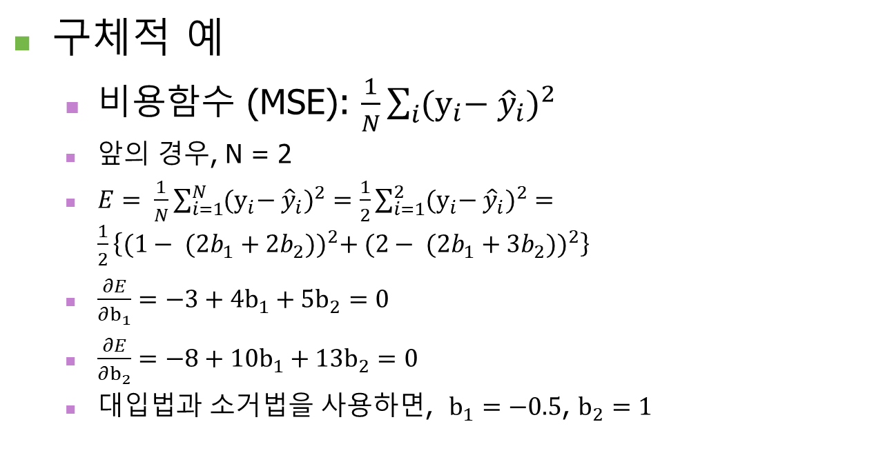
Minimization of cost function
구체적 예
비용함수 (MSE): $\frac{1}{N}\sum_{i}{{{(y}_{i}− {\hat{y}}_{i})}^{2}}$
앞의 경우, N = 2
$E= \frac{1}{N}\sum_{i=1}^{N}{{{(y}_{i}− {\hat{y}}_{i})}^{2}}=\frac{1}{2}\sum_{i=1}^{2}{{{(y}_{i}− {\hat{y}}_{i})}^{2}}=\frac{1}{2}\left\{{(1− (2b_{1}+2b_{2}))}^{2}+ {(2− (2b_{1}+3b_{2}))}^{2}\right\}$
$\frac{∂E}{∂b_{1}}=−3+4b_{1}+5b_{2}=0$
$\frac{∂E}{∂b_{2}}=−8+10b_{1}+13b_{2}=0$
대입법과 소거법을 사용하면, $b_{1}=−0.5$, $b_{2}=1$

Slide 12
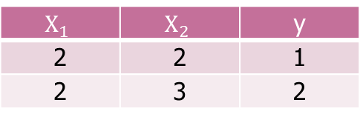
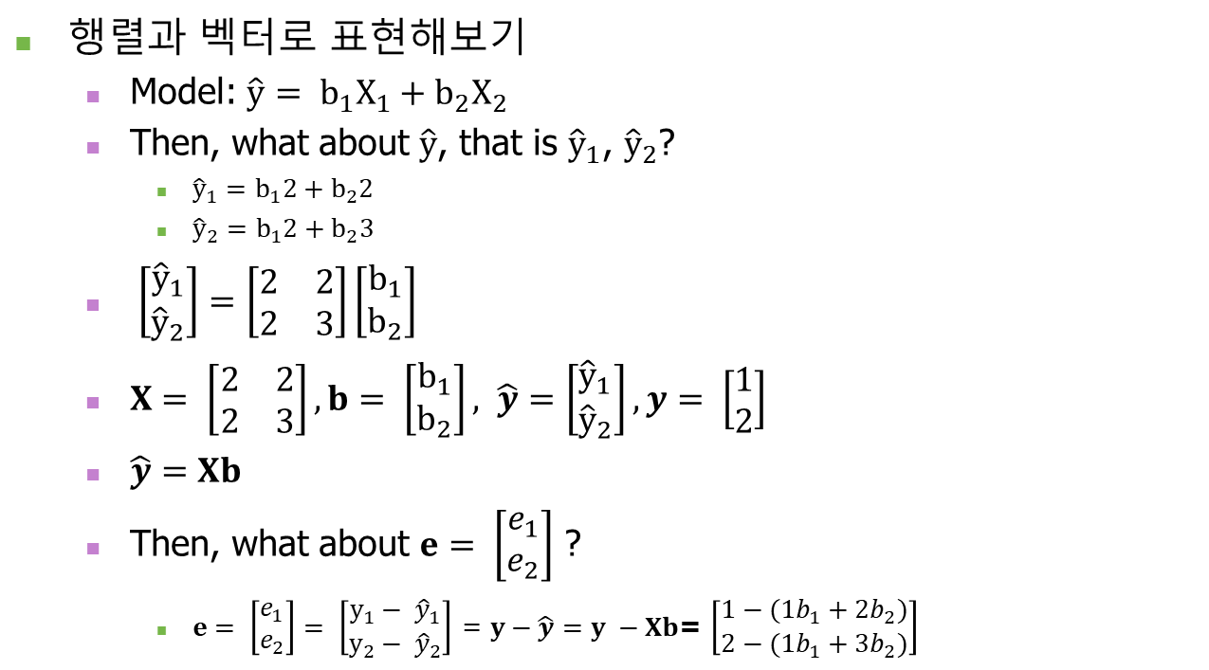
Minimization of cost function
행렬과 벡터로 표현해보기
Model: $\hat{y}= b_{1}X_{1}+b_{2}X_{2}$
Then, what about $\hat{y}$, that is ${\hat{y}}_{1}$, ${\hat{y}}_{2}$?
${\hat{y}}_{1}=$ $b_{1}2+b_{2}2$
${\hat{y}}_{2}=$ $b_{1}2+b_{2}3$
$\left[\begin{matrix}{\hat{y}}_{1} \\ {\hat{y}}_{2}\end{matrix}\right]=\left[\begin{matrix}2 & 2 \\ 2 & 3\end{matrix}\right]\left[\begin{matrix}b_{1} \\ b_{2}\end{matrix}\right]$
$X= \left[\begin{matrix}2 & 2 \\ 2 & 3\end{matrix}\right], b= \left[\begin{matrix}b_{1} \\ b_{2}\end{matrix}\right], \hat{y}=\left[\begin{matrix}{\hat{y}}_{1} \\ {\hat{y}}_{2}\end{matrix}\right], y= \left[\begin{matrix}1 \\ 2\end{matrix}\right]$
$\hat{y}=Xb$
Then, what about $e= \left[\begin{matrix}e_{1} \\ e_{2}\end{matrix}\right]$ ?
$e= \left[\begin{matrix}e_{1} \\ e_{2}\end{matrix}\right]= \left[\begin{matrix}y_{1}− {\hat{y}}_{1} \\ y_{2}− {\hat{y}}_{2}\end{matrix}\right]$ = $y−\hat{y}=y −Xb$= $\left[\begin{matrix}1−(1b_{1}+2b_{2}) \\ 2−(1b_{1}+3b_{2})\end{matrix}\right]$
X의 각행과 열이 무엇을 의미하는지를 생각하는 것이 중요
$$X_{1}$$ | $$X_{2}$$ | y
2 | 2 | 1
2 | 3 | 2

Slide 13
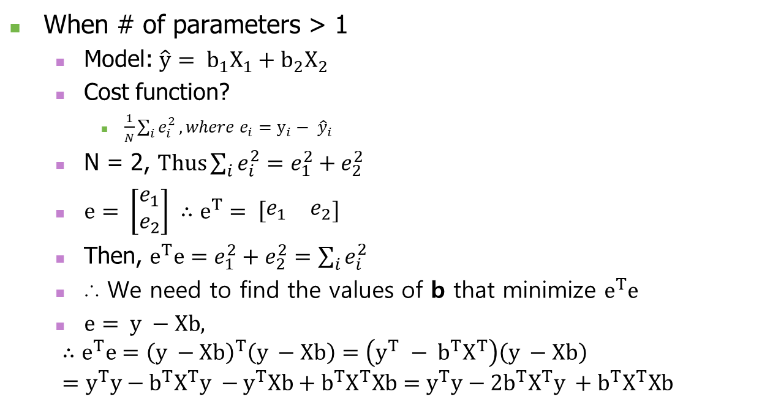
Minimization of cost function
When # of parameters > 1
Model: $\hat{y}= b_{1}X_{1}+b_{2}X_{2}$
Cost function?
$\frac{1}{N}\sum_{i}{e_{i}^{2}}, where e_{i}=y_{i}− {\hat{y}}_{i}$
N = 2, $Thus\sum_{i}{e_{i}^{2}}=e_{1}^{2}+e_{2}^{2}$
$e= \left[\begin{matrix}e_{1} \\ e_{2}\end{matrix}\right] ∴e^{T}= \left[\begin{matrix}e_{1} & e_{2}\end{matrix}\right]$
Then, $e^{T}e=e_{1}^{2}+e_{2}^{2}=\sum_{i}{e_{i}^{2}}$
∴ We need to find the values of b that minimize $e^{T}e$
$e= y −Xb,$
$$∴e^{T}e={\left(y −Xb\right)}^{T}\left(y −Xb\right)=\left(y^{T} − b^{T}X^{T}\right)\left(y −Xb\right) \\ =y^{T}y−b^{T}X^{T}y −y^{T}Xb+b^{T}X^{T}Xb=y^{T}y−2b^{T}X^{T}y +b^{T}X^{T}Xb$$
Transpose 공식
(A^{T})^{T}=A
(A+B)^{T}=A^{T}+B^{T}
(kA)^{T}=kA^{T}
(AB)^{T}=B^{T}A^{T}
Then, (A+BC)^{T}=?
1/N 은 생략 가능
최고값에 영향을 미치지 않음

Slide 14

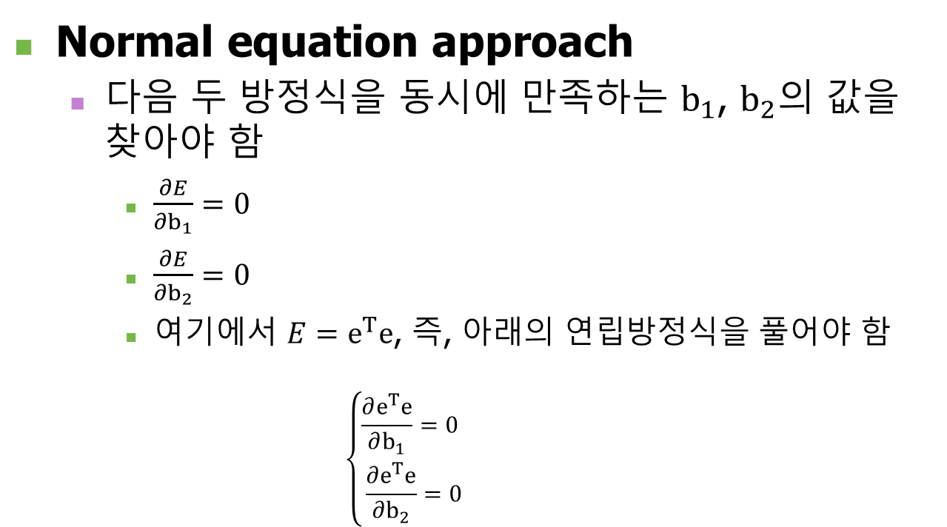
Minimization of cost function
Normal equation approach
다음 두 방정식을 동시에 만족하는 $b_{1}$, $b_{2}$의 값을 찾아야 함
$\frac{∂E}{∂b_{1}}=0$
$\frac{∂E}{∂b_{2}}=0$
여기에서 $E=e^{T}e$, 즉, 아래의 연립방정식을 풀어야 함 $\left\{\begin{aligned}\frac{∂e^{T}e}{∂b_{1}}=0 \\ \frac{∂e^{T}e}{∂b_{2}}=0\end{aligned}\right.$
$e^{T}e$는 하나의 스칼라

Slide 15
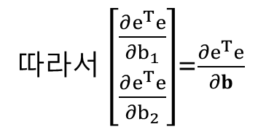
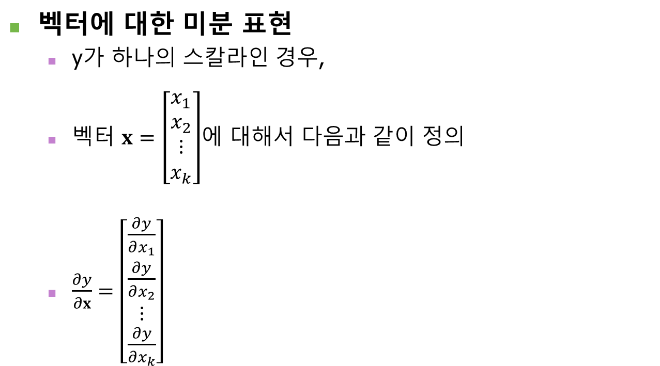
Minimization of cost function
벡터에 대한 미분 표현
y가 하나의 스칼라인 경우,
벡터 $x=\left[\begin{matrix}x_{1} \\ x_{2} \\ \begin{matrix}⋮ \\ x_{k}\end{matrix}\end{matrix}\right]$에 대해서 다음과 같이 정의
$\frac{∂y}{∂x}=\left[\begin{matrix}\frac{∂y}{∂x_{1}} \\ \frac{∂y}{∂x_{2}} \\ \begin{matrix}⋮ \\ \frac{∂y}{∂x_{k}}\end{matrix}\end{matrix}\right]$
따라서 $\left[\begin{matrix}\frac{∂e^{T}e}{∂b_{1}} \\ \frac{∂e^{T}e}{∂b_{2}}\end{matrix}\right]$=$\frac{∂e^{T}e}{∂b}$

Slide 16

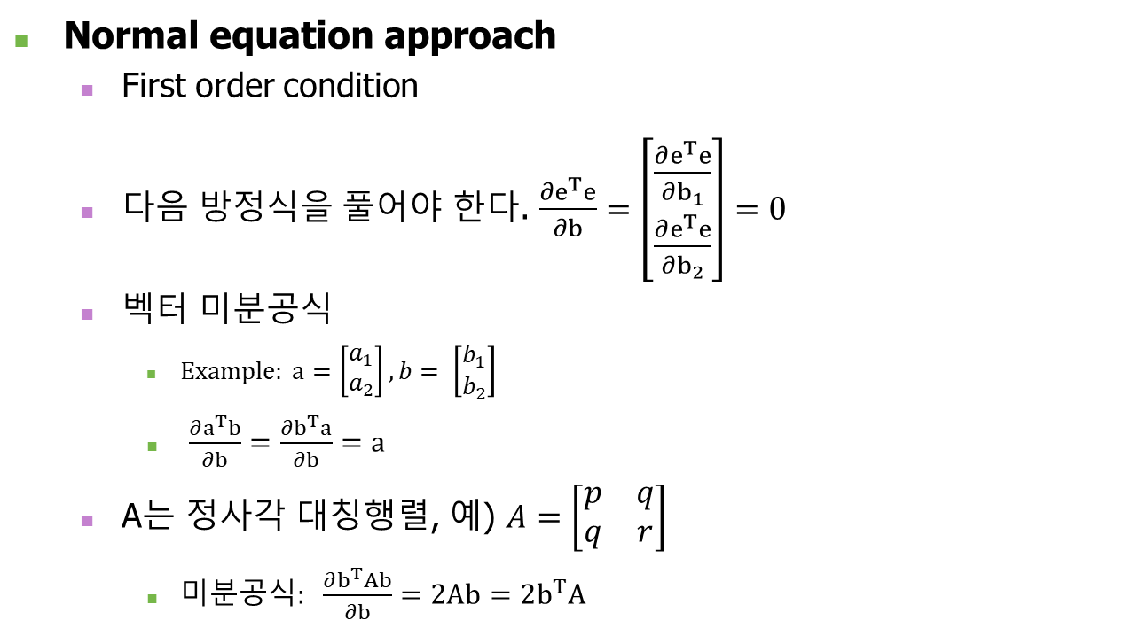

Minimization of cost function
Normal equation approach
First order condition
다음 방정식을 풀어야 한다. $\frac{∂e^{T}e}{∂b}=\left[\begin{matrix}\frac{∂e^{T}e}{∂b_{1}} \\ \frac{∂e^{T}e}{∂b_{2}}\end{matrix}\right]=0$
벡터 미분공식
$Example: a=\left[\begin{matrix}a_{1} \\ a_{2}\end{matrix}\right], b= \left[\begin{matrix}b_{1} \\ b_{2}\end{matrix}\right]$
$\frac{∂a^{T}b}{∂b}=\frac{∂b^{T}a}{∂b}=a$
A는 정사각 대칭행렬, 예) $A=\left[\begin{matrix}p & q \\ q & r\end{matrix}\right]$
미분공식$: \frac{∂b^{T}Ab}{∂b}=2Ab=2b^{T}A$
$$\frac{∂E}{∂b_{1}}$$
$$\frac{∂E}{∂b_{2}}$$
분자가 모두 스칼라

Slide 17
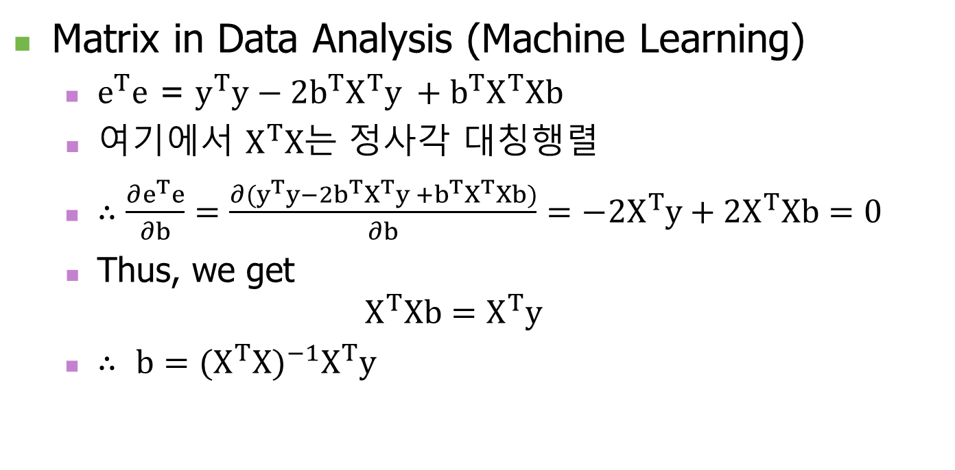
Minimization of cost function
Matrix in Data Analysis (Machine Learning)
$e^{T}e$ = $y^{T}y−2b^{T}X^{T}y +b^{T}X^{T}Xb$
여기에서 $X^{T}X$는 정사각 대칭행렬
$∴\frac{∂e^{T}e}{∂b}=\frac{∂(y^{T}y−2b^{T}X^{T}y +b^{T}X^{T}Xb)}{∂b}=−2X^{T}y+{2X}^{T}Xb=0$
Thus, we get $X^{T}Xb=X^{T}y$
$∴$ $b={{(X^{T}X)}^{−1}X}^{T}y$

Slide 18
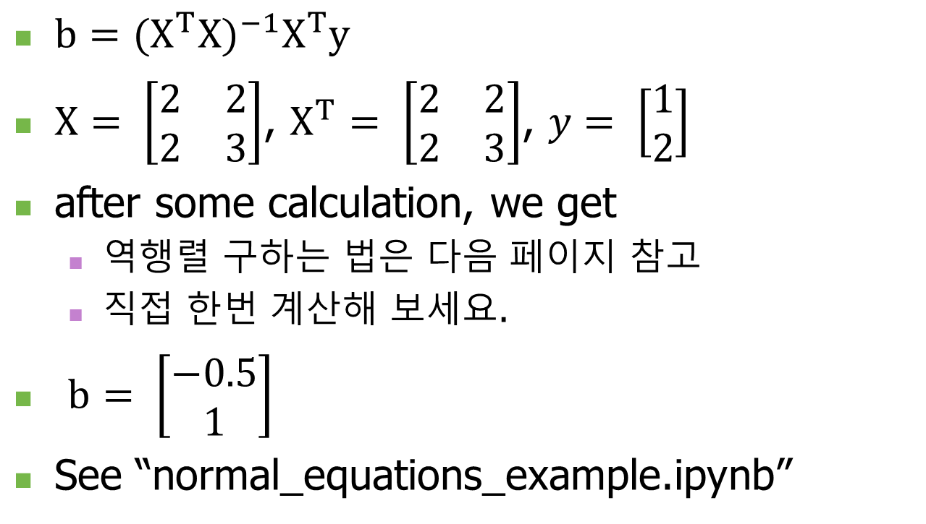
Minimization of cost function
$b={{(X^{T}X)}^{−1}X}^{T}y$
$X= \left[\begin{matrix}2 & 2 \\ 2 & 3\end{matrix}\right]$, $X^{T}= \left[\begin{matrix}2 & 2 \\ 2 & 3\end{matrix}\right]$, $y= \left[\begin{matrix}1 \\ 2\end{matrix}\right]$
after some calculation, we get
역행렬 구하는 법은 다음 페이지 참고
직접 한번 계산해 보세요.
$b= \left[\begin{matrix}−0.5 \\ 1\end{matrix}\right]$
See “normal_equations_example.ipynb”

Slide 19
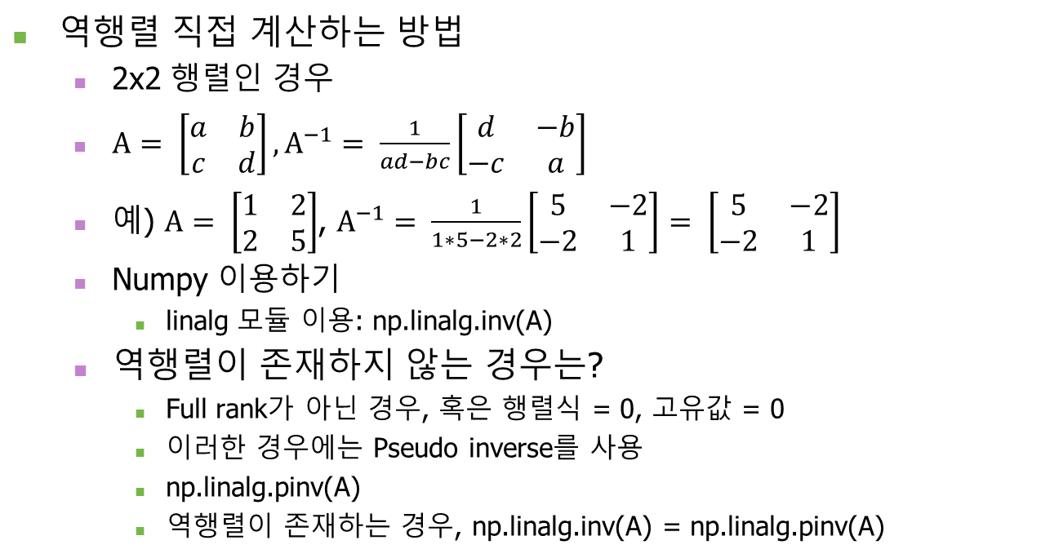
참고: 역행렬 구하는 법
역행렬 직접 계산하는 방법
2x2 행렬인 경우
$A= \left[\begin{matrix}a & b \\ c & d\end{matrix}\right], A^{−1}= \frac{1}{ad−bc}\left[\begin{matrix}d & −b \\ −c & a\end{matrix}\right]$
예) $A= \left[\begin{matrix}1 & 2 \\ 2 & 5\end{matrix}\right]$, $A^{−1}= \frac{1}{1∗5−2∗2}\left[\begin{matrix}5 & −2 \\ −2 & 1\end{matrix}\right]= \left[\begin{matrix}5 & −2 \\ −2 & 1\end{matrix}\right]$
Numpy 이용하기
linalg 모듈 이용: np.linalg.inv(A)
역행렬이 존재하지 않는 경우는?
Full rank가 아닌 경우, 혹은 행렬식 = 0, 고유값 = 0
이러한 경우에는 Pseudo inverse를 사용
np.linalg.pinv(A)
역행렬이 존재하는 경우, np.linalg.inv(A) = np.linalg.pinv(A)

Slide 20
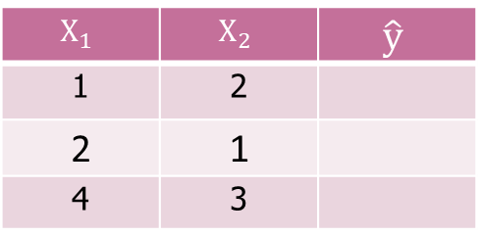
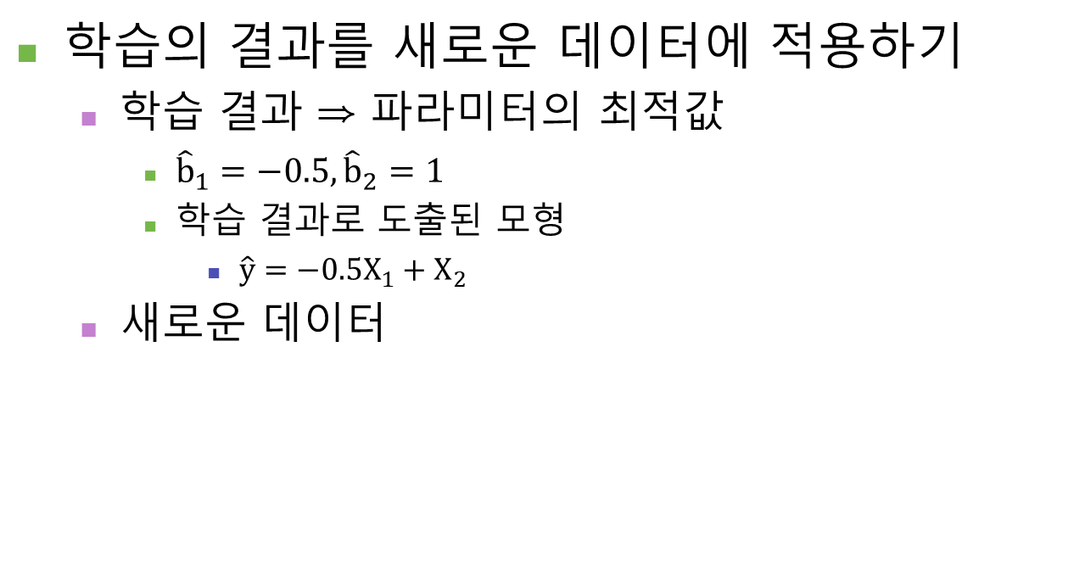
Machine Learning
학습의 결과를 새로운 데이터에 적용하기
학습 결과 ⇒ 파라미터의 최적값
${\hat{b}}_{1}=−0.5, {\hat{b}}_{2}=1$
학습 결과로 도출된 모형
$\hat{y}=−0.5X_{1}+X_{2}$
새로운 데이터
$$X_{1}$$ | $$X_{2}$$ | $$\hat{y}$$
1 | 2
2 | 1
4 | 3

Slide 21

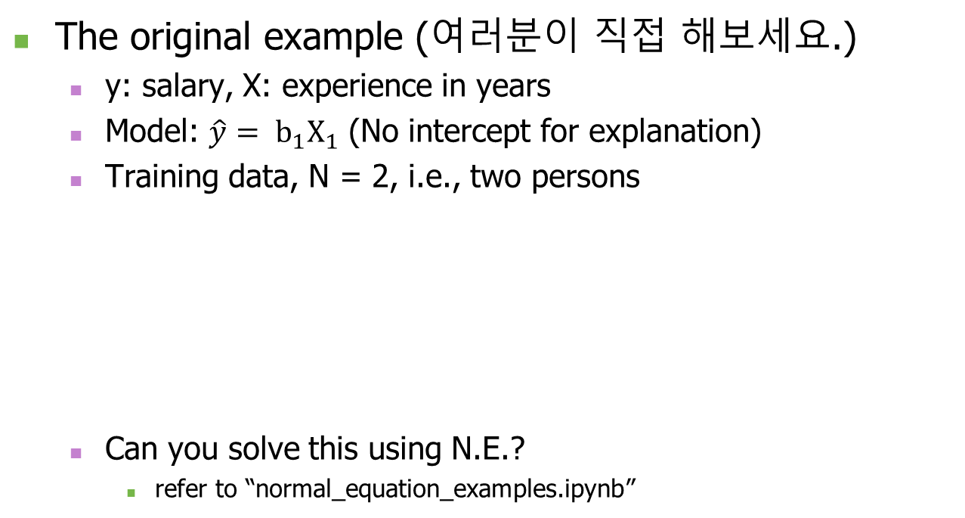
Machine Learning
The original example (여러분이 직접 해보세요.)
y: salary, X: experience in years
Model: $\hat{y}= b_{1}X_{1}$ (No intercept for explanation)
Training data, N = 2, i.e., two persons
Can you solve this using N.E.?
refer to “normal_equation_examples.ipynb”
experience | salary
1 | 2
2 | 6
Then, what is the cost function?
$$E= \frac{1}{2}\sum_{i=1}^{2}{{(y_{i}− {\hat{y}}_{i})}^{2}}$$
= $\frac{1}{2}\left[{\left(y_{1}− {\hat{y}}_{1}\right)}^{2}+{\left(y_{2}− {\hat{y}}_{2}\right)}^{2}\right]$
= $\frac{1}{2}\left[{\left(2− {1b}_{1}\right)}^{2}+{\left(6− {2b}_{1}\right)}^{2}\right]$
= ${\frac{5}{2}b_{1}}^{2}−14b_{1}+20$

Slide 22
Q & A

